Slide 1
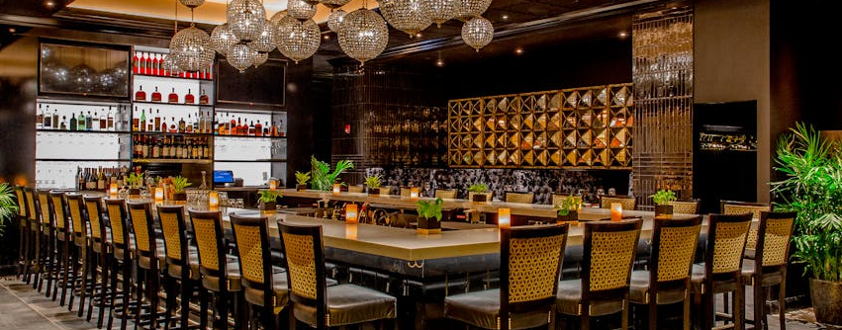

Slide 2
Team Members
K Yaswanth [AP21110010533]
Ch Nagasai [AP21110010558]
A Revanth [AP21110010556]
N Akkash [AP21110010553]

Slide 3
Abstract
The Restaurant Management System project wants to make running restaurants easier with new software.
It will help with things like taking orders, keeping track of food and staff schedules, and booking tables.
The system will be easy to use, making customers happy and work smoother for staff.
Using smart technology, it can even give useful tips to restaurant owners.
In the end, this project aims to help restaurants succeed in a busy market.

Slide 4
Introduction
The Restaurant Management System project aims to develop user-friendly software for restaurants.
It focuses on managing orders, inventory, reservations, and staff schedules efficiently.
Utilizing the latest technology and simple interfaces to streamline operations
The goal is to enhance the dining experience for both customers and staff.
Ultimately, the project aims to contribute to the success and efficiency of restaurant businesses.

Slide 5
Purpose
Create easy-to-use software for restaurants to manage their operations effectively.
Order processing, inventory tracking, and staff scheduling. Improve customer service and streamline the dining experience.
Utilize technology to enhance efficiency and reduce errors.
Support the success and growth of restaurant businesses.

Slide 6
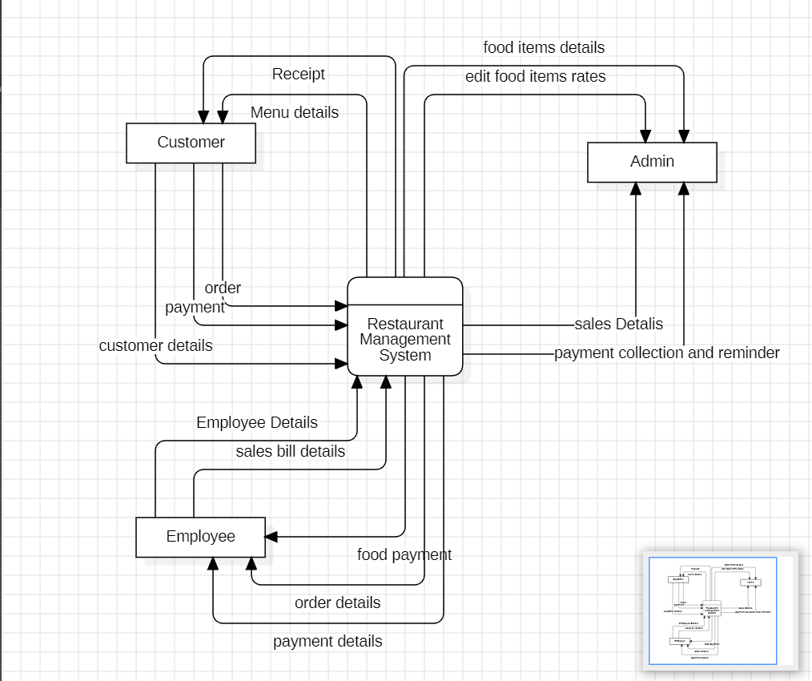
Data flow diagram - 0

Slide 7
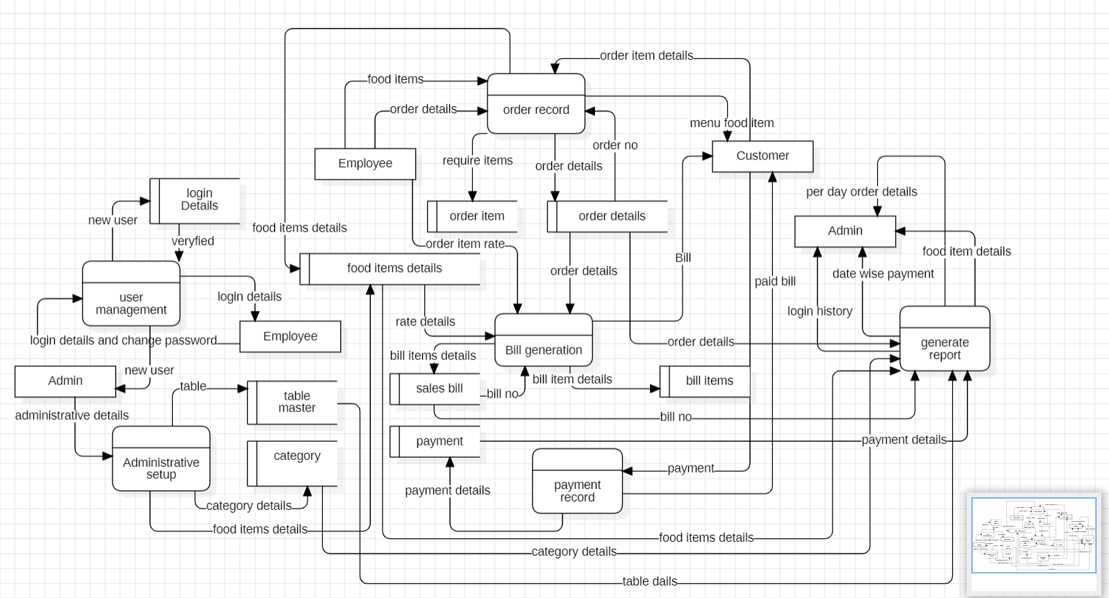
Data flow diagram - 1

Slide 8
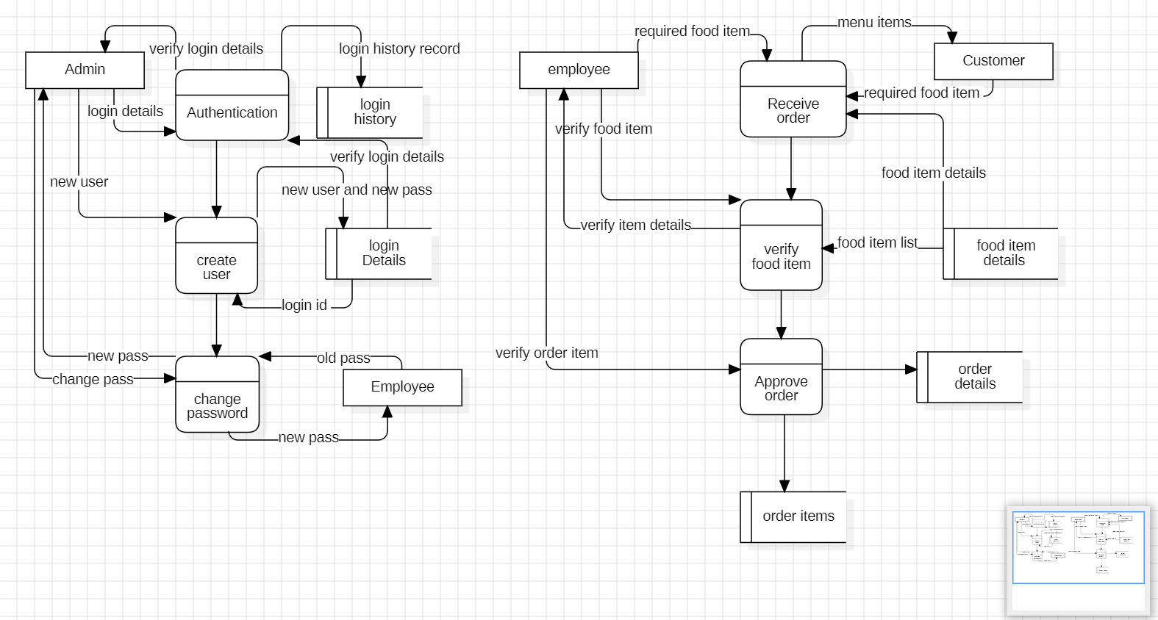
Data flow diagram - 2

Slide 9
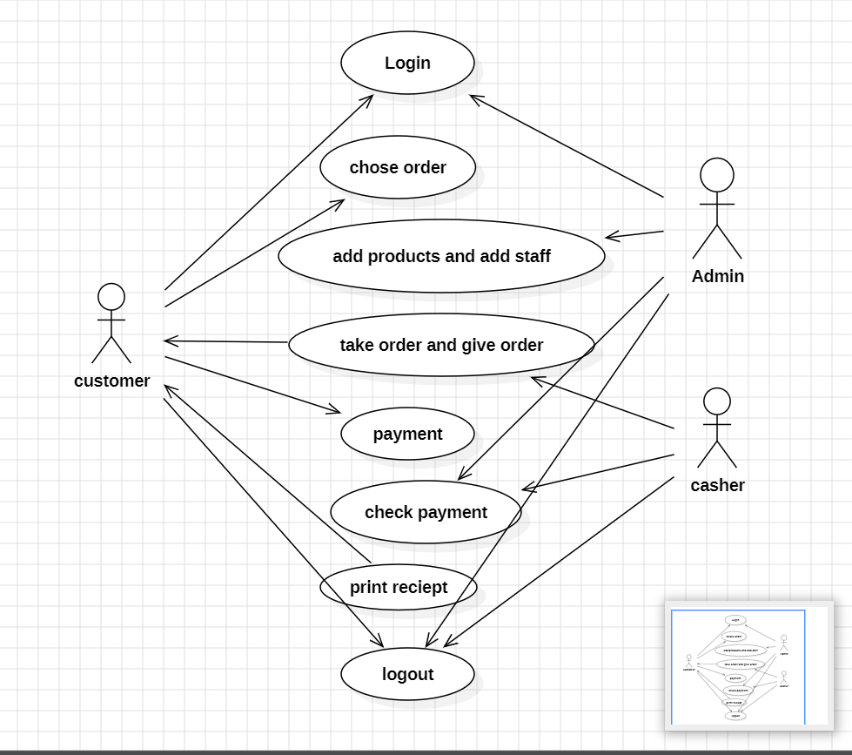
Use case diagram

Slide 10
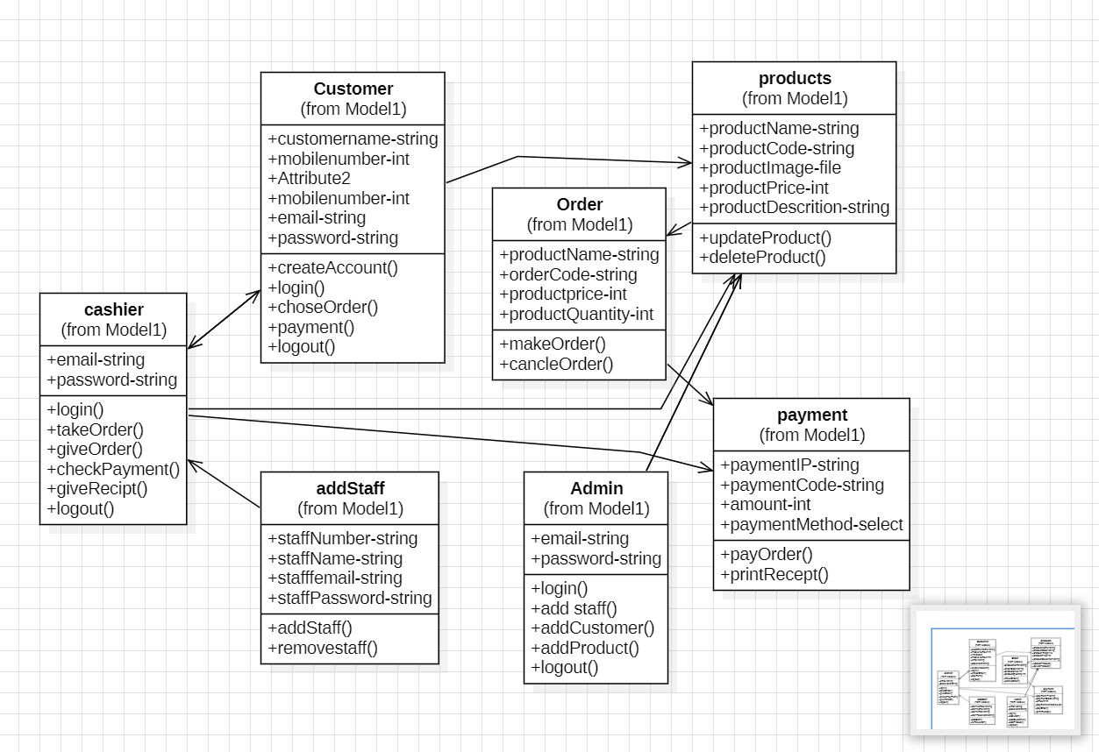
Class Diagram

Slide 11
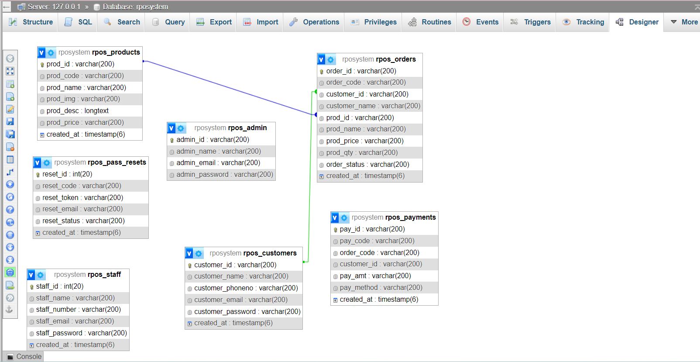
ER diagram

